Slide 1
Transaction Processing & Concurrency Control

Slide 2
Introduction to Transaction Processing
Single-User System:
At most one user at a time can use the system.
Multiuser System:
Many users can access the system concurrently.
Concurrency
Interleaved processing:
Concurrent execution of processes is interleaved in a single CPU
Parallel processing:
Processes are concurrently executed in multiple CPUs.

Slide 3
Introduction to Transaction Processing :
A Transaction:
Logical unit of database processing that includes one or more access operations (read -retrieval, write - insert or update, delete).
A transaction (set of operations) may be stand-alone specified in a high level language like SQL submitted interactively, or may be embedded within a program.
Transaction boundaries:
Begin and End transaction.
An application program may contain several transactions separated by the Begin and End transaction boundaries.

Slide 4
Introduction to Transaction Processing:
SIMPLE MODEL OF A DATABASE (for purposes of discussing transactions):
A database is a collection of named data items
Granularity of data - a field, a record , or a whole disk block (Concepts are independent of granularity)
Basic operations are read and write
read_item(X): Reads a database item named X into a program variable. To simplify our notation, we assume that the program variable is also named X.
write_item(X): Writes the value of program variable X into the database item named X.

Slide 5
READ AND WRITE OPERATIONS:
Basic unit of data transfer from the disk to the computer main memory is one block. In general, a data item (what is read or written) will be the field of some record in the database, although it may be a larger unit such as a record or even a whole block.
read_item(X) command includes the following steps:
Find the address of the disk block that contains item X.
Copy that disk block into a buffer in main memory (if that disk block is not already in some main memory buffer).
Copy item X from the buffer to the program variable named X.

Slide 6
READ AND WRITE OPERATIONS (contd.):
write_item(X) command includes the following steps:
Find the address of the disk block that contains item X.
Copy that disk block into a buffer in main memory (if that disk block is not already in some main memory buffer).
Copy item X from the program variable named X into its correct location in the buffer.
Store the updated block from the buffer back to disk (either immediately or at some later point in time).

Slide 7
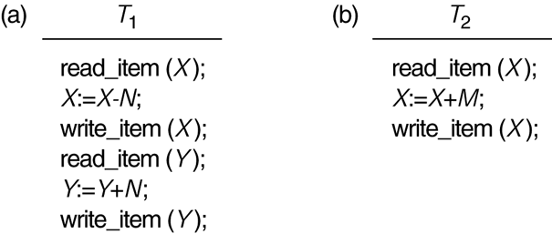
Two sample transactions
FIGURE 17.2 Two sample transactions:
(a) Transaction T1
(b) Transaction T2

Slide 8
2 Transaction and System Concepts (1)
A transaction is a unit of program execution that accesses and possibly updates various data items.
For recovery purposes, the system needs to keep track of when the transaction starts, terminates, and commits or aborts.
Transaction states:
Active state
Partially committed state
Committed state
Failed state
Terminated State

Slide 9
Recovery manager keeps track of the following operations:
begin_transaction: This marks the beginning of transaction execution.
read or write: These specify read or write operations on the database items that are executed as part of a transaction.
end_transaction: This specifies that read and write transaction operations have ended and marks the end limit of transaction execution.
At this point it may be necessary to check whether the changes introduced by the transaction can be permanently applied to the database or whether the transaction has to be aborted because it violates concurrency control or for some other reason.

Slide 10
Recovery manager keeps track of the following operations (cont):
commit_transaction: This signals a successful end of the transaction so that any changes (updates) executed by the transaction can be safely committed to the database and will not be undone.
rollback (or abort): This signals that the transaction has ended unsuccessfully, so that any changes or effects that the transaction may have applied to the database must be undone.

Slide 11
Transaction and System Concepts (4)
Recovery techniques use the following operators:
undo: Similar to rollback except that it applies to a single operation rather than to a whole transaction.
redo: This specifies that certain transaction operations must be redone to ensure that all the operations of a committed transaction have been applied successfully to the database.

Slide 12
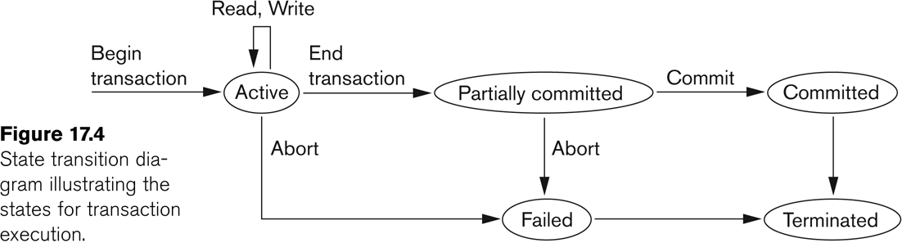
State transition diagram illustrating the states for transaction execution

Slide 13
Properties of Transactions
Atomicity
Consistency
Isolation
Durability
ACID properties

Slide 14
3 Desirable Properties of Transactions (1)
ACID properties:
Atomicity: A transaction is an atomic unit of processing; it is either performed in its entirety or not performed at all.
Consistency preservation: A correct execution of the transaction must take the database from one consistent state to another.
Isolation: A transaction should not make its updates visible to other transactions until it is committed; this property, when enforced strictly, solves the temporary update problem and makes cascading rollbacks of transactions unnecessary (see Chapter 21).
Durability or permanency: Once a transaction changes the database and the changes are committed, these changes must never be lost because of subsequent failure.

Slide 15
Why Concurrency Control is needed:

Slide 16
Concurrent Executions
Multiple transactions are allowed to run concurrently in the system. Advantages are:
Increased processor and disk utilization, leading to better transaction throughput
E.g., one transaction can be using the CPU while another is reading from or writing to the disk
Reduced average response time for transactions: short transactions need not wait behind long ones.
Concurrency control schemes – mechanisms to achieve isolation
That is, to control the interaction among the concurrent transactions in order to prevent them from destroying the consistency of the database

Slide 17
In a multi-user system, multiple users can access and use the same database at one time, which is known as the concurrent execution of the database. It means that the same database is executed simultaneously on a multi-user system by different users.
While working on the database transactions, there occurs the requirement of using the database by multiple users for performing different operations, and in that case, concurrent execution of the database is performed.
The thing is that the simultaneous execution that is performed should be done in an interleaved manner, and no operation should affect the other executing operations, thus maintaining the consistency of the database. Thus, on making the concurrent execution of the transaction operations, there occur several challenging problems that need to be solved.

Slide 18
Problems with Concurrent Execution
In a database transaction, the two main operations are READ and WRITE operations. So, there is a need to manage these two operations in the concurrent execution of the transactions as if these operations are not performed in an interleaved manner, and the data may become inconsistent. So, the following problems occur with the Concurrent Execution of the operations:
Lost Update Problems (W - W Conflict)
Dirty Read Problems (W-R Conflict)
Unrepeatable Read Problem (W-R Conflict)
The Blind Write Problem
Phantom Read Problem

Slide 19
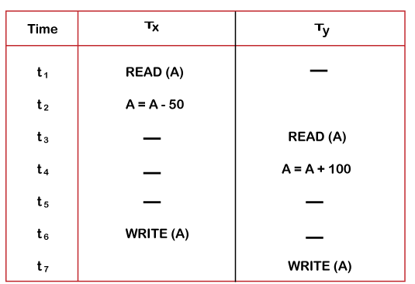
Lost Update Problems (W - W Conflict)
The problem occurs when two different database transactions perform the read/write operations on the same database items in an interleaved manner (i.e., concurrent execution) that makes the values of the items incorrect hence making the database inconsistent.
Consider the below diagram where two transactions T_{X} and T_{Y}, are performed on the same account A where the balance of account A is $300.

Slide 20
At time t1, transaction T_{X} reads the value of account A, i.e., $300 (only read).
At time t2, transaction T_{X} deducts $50 from account A that becomes $250 (only deducted and not updated/write).
Alternately, at time t3, transaction T_{Y} reads the value of account A that will be $300 only because T_{X} didn't update the value yet.
At time t4, transaction T_{Y} adds $100 to account A that becomes $400 (only added but not updated/write).
At time t6, transaction T_{X} writes the value of account A that will be updated as $250 only, as T_{Y} didn't update the value yet.
Similarly, at time t7, transaction T_{Y} writes the values of account A, so it will write as done at time t4 that will be $400. It means the value written by T_{X} is lost, i.e., $250 is lost.
Hence data becomes incorrect, and database sets to inconsistent.

Slide 21
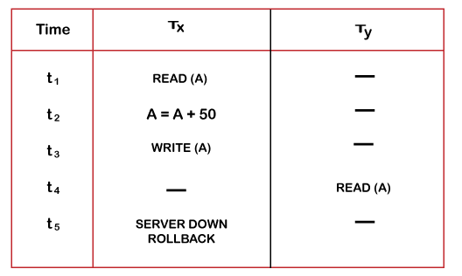
Dirty Read Problems (W-R Conflict)
The dirty read problem occurs when one transaction updates an item of the database, and somehow the transaction fails, and before the data gets rollback, the updated database item is accessed by another transaction.
Consider two transactions T_{X} and T_{Y} in the below diagram performing read/write operations on account A where the available balance in account A is $300:

Slide 22
At time t1, transaction T_{X} reads the value of account A, i.e., $300.
At time t2, transaction T_{X} adds $50 to account A that becomes $350.
At time t3, transaction T_{X} writes the updated value in account A, i.e., $350.
Then at time t4, transaction T_{Y} reads account A that will be read as $350.
Then at time t5, transaction T_{X} rollbacks due to server problem, and the value changes back to $300 (as initially).
But the value for account A remains $350 for transaction T_{Y} as committed, which is the dirty read and therefore known as the Dirty Read Problem.

Slide 23
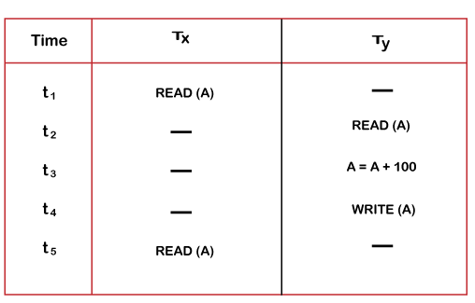
Unrepeatable Read Problem (W-R Conflict)
Also known as Inconsistent Retrievals Problem that occurs when in a transaction, two different values are read for the same database item.
Consider two transactions, T_{X} and T_{Y}, performing the read/write operations on account A, having an available balance = $300. The diagram is shown below:

Slide 24
At time t1, transaction T_{X} reads the value from account A, i.e., $300.
At time t2, transaction T_{Y} reads the value from account A, i.e., $300.
At time t3, transaction T_{Y} updates the value of account A by adding $100 to the available balance, and then it becomes $400.
At time t4, transaction T_{Y} writes the updated value, i.e., $400.
After that, at time t5, transaction T_{X} reads the available value of account A, and that will be read as $400.
It means that within the same transaction T_{X}, it reads two different values of account A, i.e., $ 300 initially, and after updation made by transaction T_{Y}, it reads $400. It is an unrepeatable read and is therefore known as the Unrepeatable read problem.

Slide 25
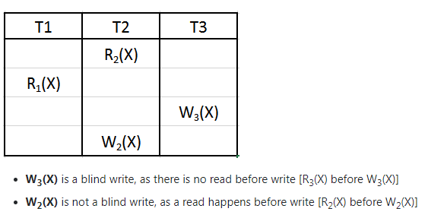
The Blind Write Problem
If one transaction writes a value without reading it.

Slide 26
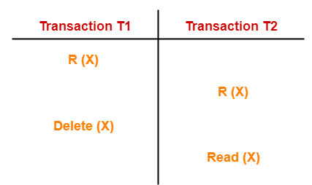
Phantom Read Problem-
This problem occurs when a transaction reads some variable from the buffer and when it reads the same variable later, it finds that the variable does not exist.
Here,
T1 reads X.
T2 reads X.
T1 deletes X.
T2 tries reading X but does not find it.
In this example,
T2 finds that there does not exist any variable X when it tries reading X again.
T2 wonders who deleted the variable X because according to it, it is running in isolation.

Slide 27
Thus, in order to maintain consistency in the database and avoid such problems that take place in concurrent execution, management is needed, and that is where the concept of Concurrency Control comes into role.

Slide 28
Why recovery is needed:

Slide 29
Introduction to Transaction Processing
Why recovery is needed:
(What causes a Transaction to fail)
1. A computer failure (system crash):
A hardware or software error occurs in the computer system during transaction execution. If the hardware crashes, the contents of the computer’s internal memory may be lost.
2. A transaction or system error:
Some operation in the transaction may cause it to fail, such as integer overflow or division by zero. Transaction failure may also occur because of erroneous parameter values or because of a logical programming error. In addition, the user may interrupt the transaction during its execution.

Slide 30
Introduction to Transaction Processing
Why recovery is needed (Contd.):
(What causes a Transaction to fail)
3. Local errors or exception conditions detected by the transaction:
Certain conditions necessitate cancellation of the transaction. For example, data for the transaction may not be found. A condition, such as insufficient account balance in a banking database, may cause a transaction, such as a fund withdrawal from that account, to be canceled.
A programmed abort in the transaction causes it to fail.
4. Concurrency control enforcement:
The concurrency control method may decide to abort the transaction, to be restarted later, because it violates serializability or because several transactions are in a state of deadlock (see later).

Slide 31
Introduction to Transaction Processing
Why recovery is needed (contd.):
(What causes a Transaction to fail)
5. Disk failure:
Some disk blocks may lose their data because of a read or write malfunction or because of a disk read/write head crash. This may happen during a read or a write operation of the transaction.
6. Physical problems and catastrophes:
This refers to an endless list of problems that includes power or air-conditioning failure, fire, theft, sabotage, overwriting disks or tapes by mistake, and mounting of a wrong tape by the operator.

Slide 32
Transaction and System Concepts
The System Log
Log or Journal: The log keeps track of all transaction operations that affect the values of database items.
This information may be needed to permit recovery from transaction failures.
The log is kept on disk, so it is not affected by any type of failure except for disk or catastrophic failure.
In addition, the log is periodically backed up to archival storage (tape) to guard against such catastrophic failures.

Slide 33
The System Log (cont):
T in the following discussion refers to a unique transaction-id that is generated automatically by the system and is used to identify each transaction:
Types of log record:
[start_transaction,T]: Records that transaction T has started execution.
[write_item,T,X,old_value,new_value]: Records that transaction T has changed the value of database item X from old_value to new_value.
[read_item,T,X]: Records that transaction T has read the value of database item X.
[commit,T]: Records that transaction T has completed successfully, and affirms that its effect can be committed (recorded permanently) to the database.
[abort,T]: Records that transaction T has been aborted.

Slide 34
Commit Point of a Transaction:
Definition a Commit Point:
A transaction T reaches its commit point when all its operations that access the database have been executed successfully and the effect of all the transaction operations on the database has been recorded in the log.
Beyond the commit point, the transaction is said to be committed, and its effect is assumed to be permanently recorded in the database.
The transaction then writes an entry [commit, T] into the log.
Roll Back of transactions:
Needed for transactions that have a [start_transaction,T] entry into the log but no commit entry [commit, T] into the log.

Slide 35
Commit Point of a Transaction (cont):
Redoing transactions:
Transactions that have written their commit entry in the log must also have recorded all their write operations in the log; otherwise they would not be committed, so their effect on the database can be redone from the log entries. (Notice that the log file must be kept on disk.
At the time of a system crash, only the log entries that have been written back to disk are considered in the recovery process because the contents of main memory may be lost.)
Force writing a log:
Before a transaction reaches its commit point, any portion of the log that has not been written to the disk yet must now be written to the disk.
This process is called force-writing the log file before committing a transaction.

Slide 36
Schedules
Transaction schedule or history:
When transactions are executing concurrently in an interleaved fashion, the order of execution of operations from the various transactions forms what is known as a transaction schedule (or history).
A schedule (or history) S of n transactions T1, T2, …, Tn:
It is an ordering of the operations of the transactions subject to the constraint that, for each transaction Ti that participates in S, the operations of T1 in S must appear in the same order in which they occur in T1.
Note, however, that operations from other transactions Tj can be interleaved with the operations of Ti in S.

Slide 37
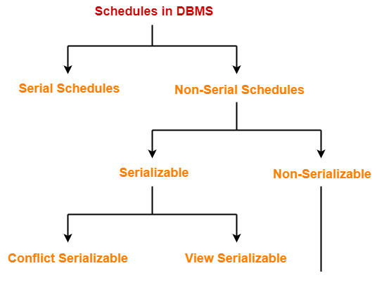

Slide 38
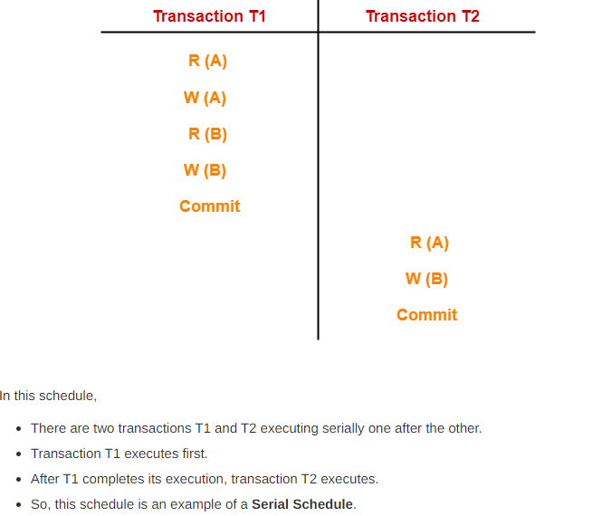

Slide 39
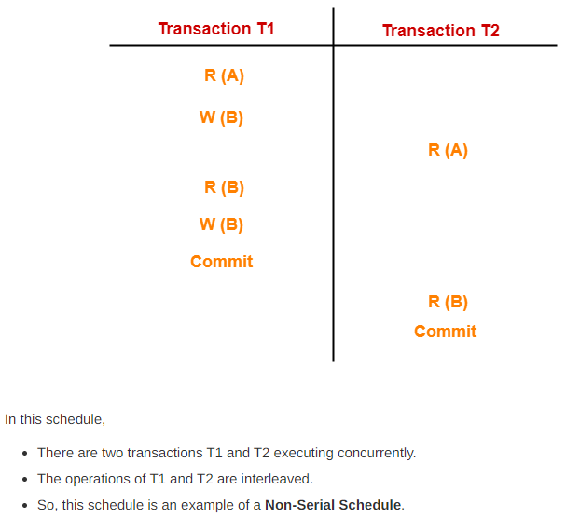
Non-Serial Schedules-
In non-serial schedules,
Multiple transactions execute concurrently.
Operations of all the transactions are inter leaved or mixed with each other.

Slide 40
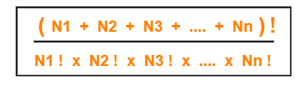
Finding Number Of Schedules-
Consider there are n number of transactions T1, T2, T3 …. , Tn with N1, N2, N3 …. , Nn number of operations respectively.
Total Number of Schedules-
Total number of possible schedules (serial + non-serial) is given by-
Total Number of Serial Schedules-
Total number of serial schedules
= Number of different ways of arranging n transactions
= n!
Total Number of Non-Serial Schedules-
Total number of non-serial schedules
= Total number of schedules – Total number of serial schedules

Slide 41
Consider there are three transactions with 2, 3, 4 operations respectively, find-
How many total number of schedules are possible?
(2+3+4)!/2! X 3! X 4! = 1260
How many total number of serial schedules are possible? -3! =6
How many total number of non-serial schedules are possible? -1254

Slide 42
We have discussed-
A schedule is the order in which the operations of multiple transactions appear for execution.
Serial schedules are always consistent.
Non-serial schedules are not always consistent.

Slide 43
Serializability in DBMS-
Some non-serial schedules may lead to inconsistency of the database.
Serializability is a concept that helps to identify which non-serial schedules are correct and will maintain the consistency of the database.
Serializable Schedules-
If a given non-serial schedule of ‘n’ transactions is equivalent to some serial schedule of ‘n’ transactions, then it is called as a serializable schedule.

Slide 44
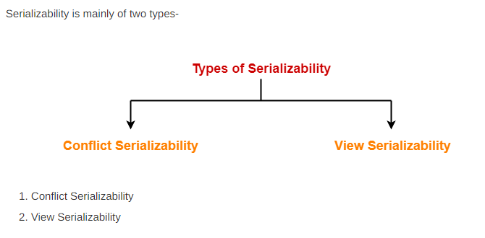

Slide 45
Conflict Serializability-
If a given non-serial schedule can be converted into a serial schedule by swapping its non-conflicting operations, then it is called as a conflict serializable schedule.
Conflicting Operations-
Two operations are called as conflicting operations if all the following conditions hold true for them-
Both the operations belong to different transactions
Both the operations are on the same data item
At least one of the two operations is a write operation
3 kinds of conflicts
RW (Read – Write) Conflict
WR (Write – Read) Conflict
WW (Write – Write) Conflict

Slide 46
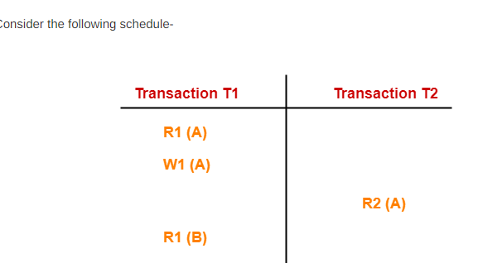
In this schedule,
W1 (A) and R2 (A) are called as conflicting operations.
This is because all the above conditions hold true for them.

Slide 47
Testing Conflict Serializability
Using Precedence Graph
It is not always possible to test whether a given schedule is conflict serializable by manual methods because there may be thousands of transactions executing concurrently.
Therefore, method which can test a given schedule for its conflict serializability is introduced using precedence graph.

Slide 48
Testing Conflict Serializability
Using Precedence Graph
Looks at only read_Item (X) and write_Item (X) operations
Constructs a precedence graph (serialization graph) - a graph with directed edges
An edge is created from Ti to Tj if one of the operations in Ti appears before a conflicting operation in Tj
The schedule is serializable if and only if the precedence graph has no cycles.

Slide 49
1] Check whether the given schedule S is conflict serializable or not-
S : R₁(A) , R₂(A) , R₁(B) , R₂(B) , R₃(B) , W₁(A) , W₂(B)
STEP 1:
List all the conflicting operations and determine the dependency between the transactions-
R₂(A) , W₁(A) (T₂ → T₁)
R₁(B) , W₂(B) (T₁ → T₂)
R₃(B) , W₂(B) (T₃ → T₂)

Slide 50
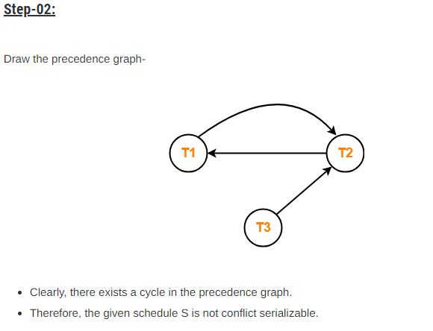

Slide 51
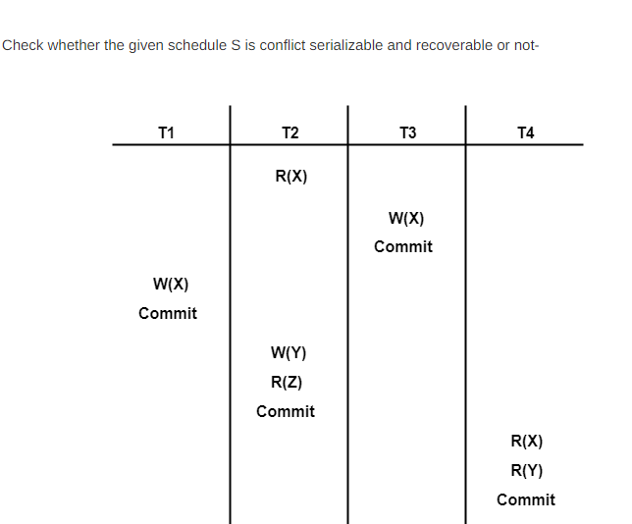

Slide 52
List all the conflicting operations and determine the dependency between the transactions-
R₂(X) , W₃(X) (T₂ → T₃)
R₂(X) , W₁(X) (T₂ → T₁)
W₃(X) , W₁(X) (T₃ → T₁)
W₃(X) , R₄(X) (T₃ → T₄)
W₁(X) , R₄(X) (T₁ → T₄)
W₂(Y) , R₄(Y) (T₂ → T₄)

Slide 53
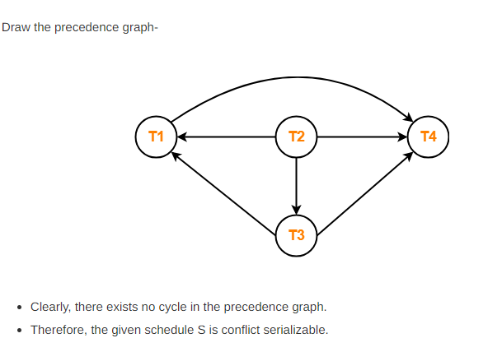

Slide 54
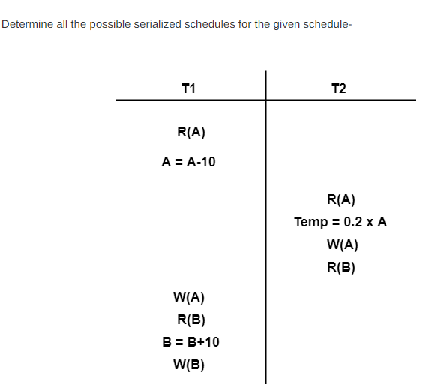

Slide 55
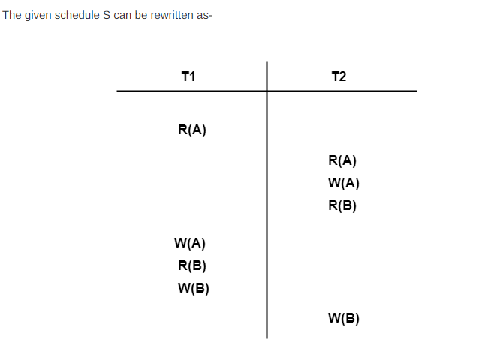

Slide 56
Checking Whether S is Conflict Serializable Or Not-
Step-01:
List all the conflicting operations and determine the dependency between the transactions-
R₁(A) , W₂(A) (T₁ → T₂)
R₂(A) , W₁(A) (T₂ → T₁)
W₂(A) , W₁(A) (T₂ → T₁)
R₂(B) , W₁(B) (T₂ → T₁)
R₁(B) , W₂(B) (T₁ → T₂)
W₁(B) , W₂(B) (T₁ → T₂)

Slide 57
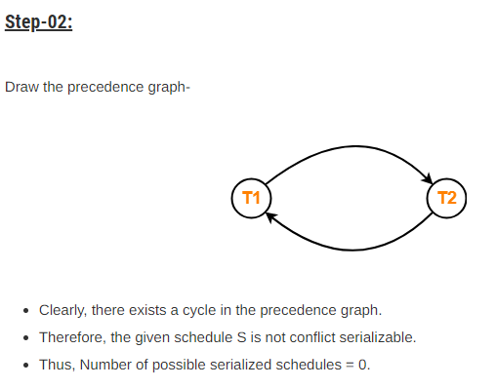

Slide 58
View Serializability-
If a given schedule is found to be view equivalent to some serial schedule, then it is called as a view serializable schedule.
View Equivalent Schedules-
Consider two schedules S1 and S2 each consisting of two transactions T1 and T2.
Schedules S1 and S2 are called view equivalent if the following three conditions hold true for them-
1. For each data item X, if transaction T_{i} reads X from the database initially in schedule S1, then in schedule S2 also, T_{i} must perform the initial read of X from the database.
Thumb Rule
“Initial readers must be same for all the data items”.

Slide 59
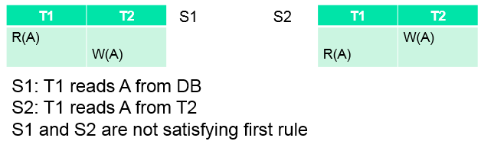
Schedules S1 and S2 are called view equivalent if the following three conditions hold true for them-
1. For each data item X, if transaction T_{i} reads X from the database initially in schedule S1, then in schedule S2 also, T_{i} must perform the initial read of X from the database.
Thumb Rule
“Initial readers must be same for all the data items”.

Slide 60
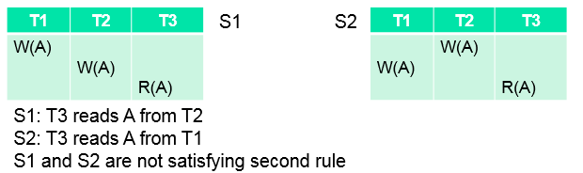
2. If transaction T_{i} reads a data item that has been updated by the transaction T_{j} in schedule S1, then in schedule S2 also, transaction T_{i} must read the same data item that has been updated by the transaction T_{j.}
Thumb Rule
“Write-read sequence must be same.”.

Slide 61
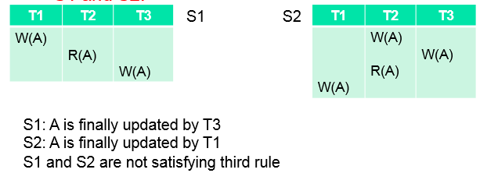
3. For each data item X, if X has been updated at last by transaction T_{i} in schedule S1, then in schedule S2 also, X must be updated at last by transaction T_{i}.
Thumb Rule
“Final writers must be same for all the data items”.

Slide 62
A schedule is view serializable, if it is view equivalent to its serial schedule.

Slide 63
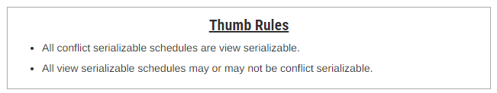
Checking Whether a Schedule is View Serializable Or Not-
Method-01:
Check whether the given schedule is conflict serializable or not.
If the given schedule is conflict serializable, then it is surely view serializable. Stop and report your answer.
If the given schedule is not conflict serializable, then it may or may not be view serializable. Go and check using other methods.

Slide 64

Method-02:
Check if there exists any blind write operation.
(Writing without reading is called as a blind write).
If there does not exist any blind write, then the schedule is surely not view serializable. Stop and report your answer.
If there exists any blind write, then the schedule may or may not be view serializable. Go and check using other methods.

Slide 65
Method-03:
In this method, try finding a view equivalent serial schedule.
By using the above three conditions, write all the dependencies.
Then, draw a graph using those dependencies.
If there exists no cycle in the graph, then the schedule is view serializable otherwise not.

Slide 66
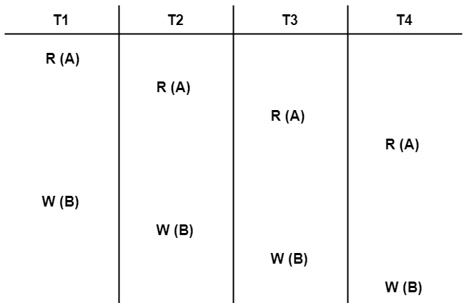
1]Check whether the given schedule S is view serializable or not-

Slide 67
Solution-
We know, if a schedule is conflict serializable, then it is surely view serializable.
So, let us check whether the given schedule is conflict serializable or not.
STEP 1:
List all the conflicting operations and determine the dependency between the transactions-
W₁(B) , W₂(B) (T₁ → T₂)
W₁(B) , W₃(B) (T₁ → T₃)
W₁(B) , W₄(B) (T₁ → T₄)
W₂(B) , W₃(B) (T₂ → T₃)
W₂(B) , W₄(B) (T₂ → T₄)
W₃(B) , W₄(B) (T₃ → T₄)

Slide 68
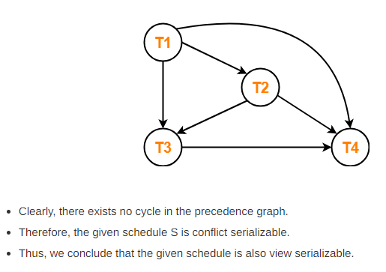
Step-02:
Draw the precedence graph-

Slide 69
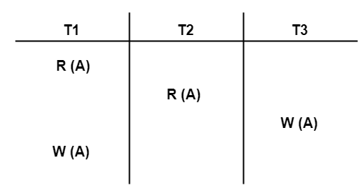
2]Check whether the given schedule S is view serializable or not-
We know, if a schedule is conflict serializable, then it is surely view serializable.
So, let us check whether the given schedule is conflict serializable or not.

Slide 70
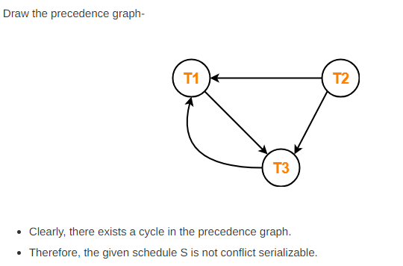
List all the conflicting operations and determine the dependency between the transactions-
R₁(A) , W₃(A) (T₁ → T₃)
R₂(A) , W₃(A) (T₂ → T₃)
R₂(A) , W₁(A) (T₂ → T₁)
W₃(A) , W₁(A) (T₃ → T₁)

Slide 71
Now, Since, the given schedule S is not conflict serializable, so, it may or may not be view serializable.
To check whether S is view serializable or not, let us use another method.
Let us check for blind writes.
Checking for Blind Writes-
There exists a blind write W₃ (A) in the given schedule S.
Therefore, the given schedule S may or may not be view serializable.
Now, To check whether S is view serializable or not, let us use another method.
Let us derive the dependencies and then draw a dependency graph.

Slide 72
Drawing a Dependency Graph-
T1 firstly reads A and T3 firstly updates A.
So, T1 must execute before T3.
Thus, we get the dependency T1 → T3.
Final updation on A is made by the transaction T1.
So, T1 must execute after all other transactions.
Thus, we get the dependency (T2, T3) → T1.
There exists no write-read sequence.
Now, let us draw a dependency graph using these dependencies-

Slide 73
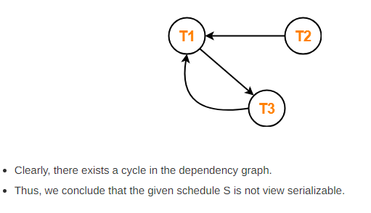
T1 → T3.
(T2, T3) → T1

Slide 74
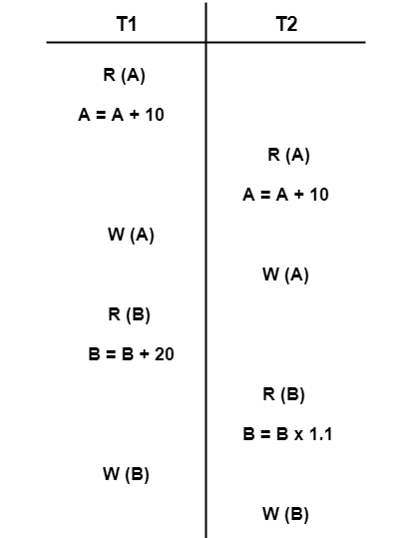
3] Check whether the given schedule S is view serializable or not-

Slide 75
We know, if a schedule is conflict serializable, then it is surely view serializable.
So, let us check whether the given schedule is conflict serializable or not.
Checking Whether S is Conflict Serializable Or Not-
Step-01:
List all the conflicting operations and determine the dependency between the transactions-
R₁(A) , W₂(A) (T₁ → T₂)
R₂(A) , W₁(A) (T₂ → T₁)
W₁(A) , W₂(A) (T₁ → T₂)
R₁(B) , W₂(B) (T₁ → T₂)
R₂(B) , W₁(B) (T₂ → T₁)

Slide 76
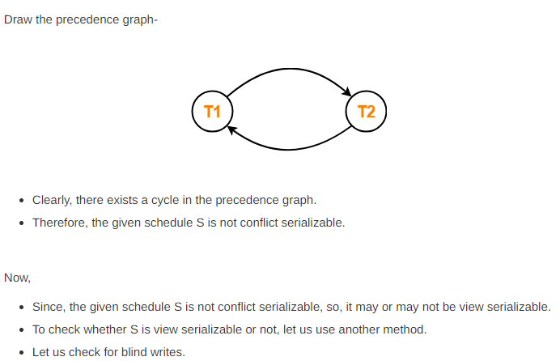

Slide 77
Checking for Blind Writes-
There exists no blind write in the given schedule S.
Therefore, it is surely not view serializable.
Alternatively,
You could directly declare that the given schedule S is not view serializable.
This is because there exists no blind write in the schedule.
You need not check for conflict serializability.

Slide 78
Non-Serializable Schedules
A non-serial schedule which is not serializable is called as a non-serializable schedule.
A non-serializable schedule is not guaranteed to produce the the same effect as produced by some serial schedule on any consistent database.
Characteristics-
Non-serializable schedules-
may or may not be consistent
may or may not be recoverable
Irrecoverable Schedules-
If in a schedule,
A transaction performs a dirty read operation from an uncommitted transaction
And commits before the transaction from which it has read the value then such a schedule is known as an Irrecoverable Schedule.

Slide 79
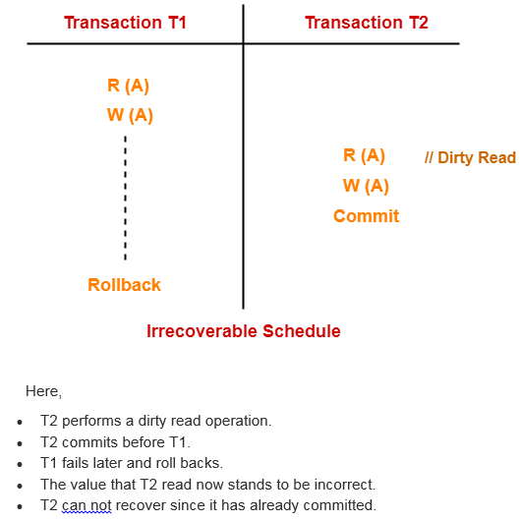

Slide 80
Recoverable Schedules-
If in a schedule,
A transaction performs a dirty read operation from an uncommitted transaction
And its commit operation is delayed till the uncommitted transaction either commits or roll backs then such a schedule is known as a Recoverable Schedule.
Here,
The commit operation of the transaction that performs the dirty read is delayed.
This ensures that it still has a chance to recover if the uncommitted transaction fails later.

Slide 81
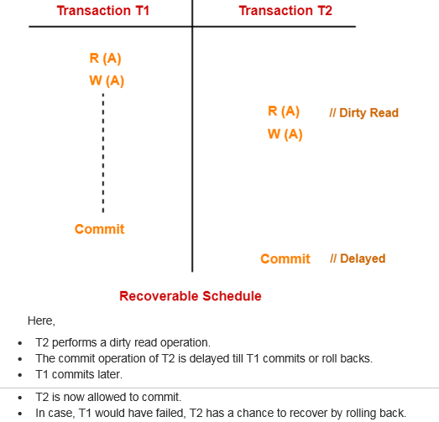

Slide 82
Checking Whether a Schedule is Recoverable or Irrecoverable-
METHOD 1
Check whether the given schedule is conflict serializable or not.
If the given schedule is conflict serializable, then it is surely recoverable. Stop and report your answer.
If the given schedule is not conflict serializable, then it may or may not be recoverable. Go and check using other methods.
Thumb Rules All conflict serializable schedules are recoverable. All recoverable schedules may or may not be conflict serializable.

Slide 83
Method-02:
Check if there exists any dirty read operation.
(Reading from an uncommitted transaction is called as a dirty read)
If there does not exist any dirty read operation, then the schedule is surely recoverable. Stop and report your answer.
If there exists any dirty read operation, then the schedule may or may not be recoverable.
If there exists a dirty read operation, then follow the following cases-
Case-01:
If the commit operation of the transaction performing the dirty read occurs before the commit or abort operation of the transaction which updated the value, then the schedule is irrecoverable.
Case-02:
If the commit operation of the transaction performing the dirty read is delayed till the commit or abort operation of the transaction which updated the value, then the schedule is recoverable.

Slide 84
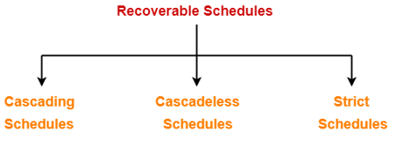
Recoverable Schedules-
If in a schedule,
A transaction performs a dirty read operation from an uncommitted transaction
And its commit operation is delayed till the uncommitted transaction either commits or roll backs then such a schedule is called as a Recoverable Schedule.
Types of Recoverable Schedules-
A recoverable schedule may be any one of these kinds-

Slide 85
Cascading Schedule-
If in a schedule, failure of one transaction causes several other dependent transactions to rollback or abort, then such a schedule is called as a Cascading Schedule or Cascading Rollback or Cascading Abort.
It simply leads to the wastage of CPU time.

Slide 86
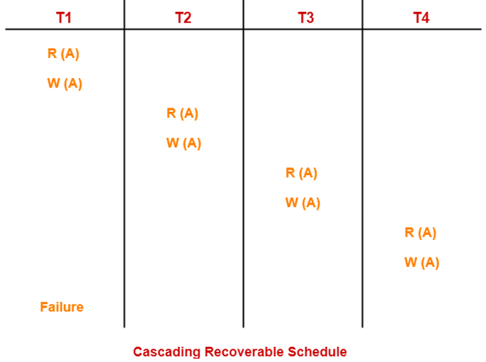
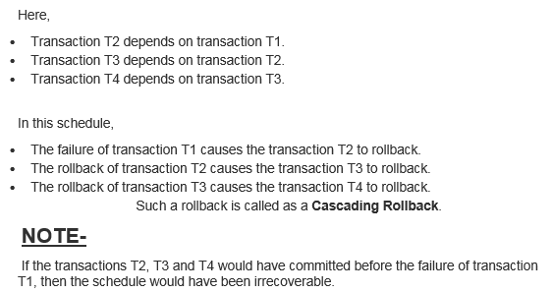

Slide 87
Cascadeless Schedule-
If in a schedule, a transaction is not allowed to read a data item until the last transaction that has written it is committed or aborted, then such a schedule is called as a Cascadeless Schedule.
In other words,
Cascadeless schedule allows only committed read operations.
Therefore, it avoids cascading roll back and thus saves CPU time.

Slide 88
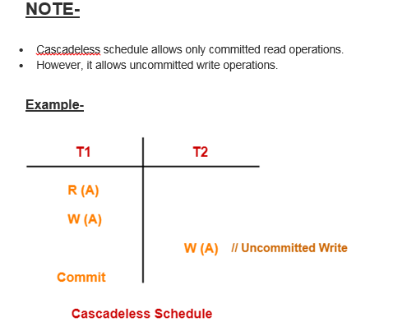
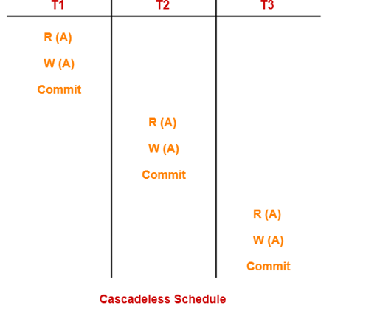

Slide 89
Strict Schedule-
If in a schedule, a transaction is neither allowed to read nor write a data item until the last transaction that has written it is committed or aborted, then such a schedule is called as a Strict Schedule.
In other words,
Strict schedule allows only committed read and write operations.
Clearly, strict schedule implements more restrictions than cascadeless schedule.

Slide 90
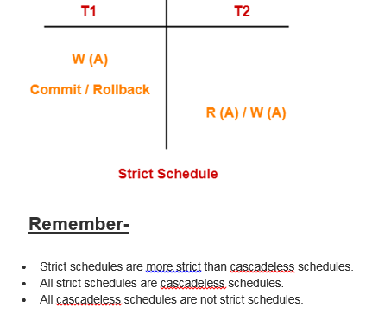
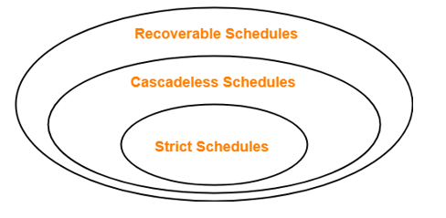

Slide 91
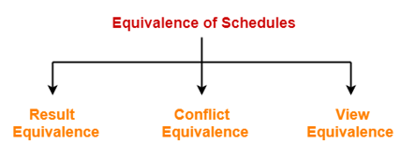
Equivalence of Schedules-
In DBMS, schedules may have the following three different kinds of equivalence relations among them-

Slide 92
1. Result Equivalent Schedules-
If any two schedules generate the same result after their execution, then they are called as result equivalent schedules.
This equivalence relation is considered of least significance.
This is because some schedules might produce same results for some set of values and different results for some other set of values.
2. Conflict Equivalent Schedules-
If any two schedules satisfy the following two conditions, then they are called as conflict equivalent schedules-
The set of transactions present in both the schedules is same.
The order of pairs of conflicting operations of both the schedules is same.
3. View Equivalent Schedules-
We have already discussed about View Equivalent Schedules

Slide 93
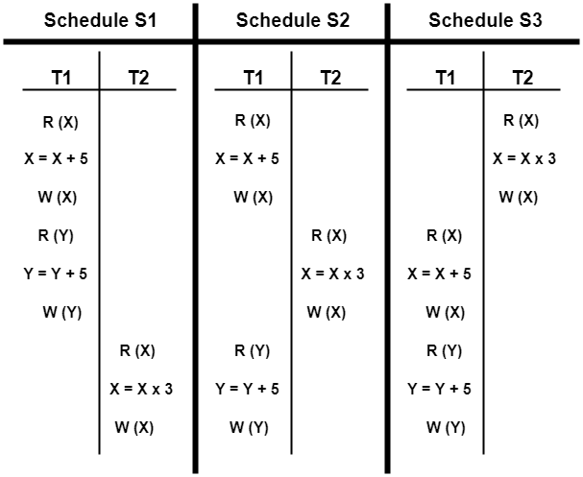
Are the following three schedules result equivalent?

Slide 94
To check whether the given schedules are result equivalent or not,
We will consider some arbitrary values of X and Y.
Then, we will compare the results produced by each schedule.
Those schedules which produce the same results will be result equivalent.
Let X = 2 and Y = 5.
On substituting these values, the results produced by each schedule are-
Results by Schedule S1- X = 21 and Y = 10
Results by Schedule S2- X = 21 and Y = 10
Results by Schedule S3- X = 11 and Y = 10
Clearly, the results produced by schedules S1 and S2 are same.
Thus, we conclude that S1 and S2 are result equivalent schedules.

Slide 95
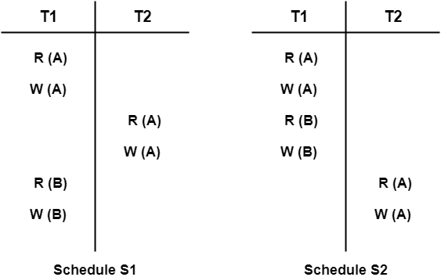
Are the following two schedules conflict equivalent?

Slide 96
To check whether the given schedules are conflict equivalent or not,
We will write their order of pairs of conflicting operations.
Then, we will compare the order of both the schedules.
If both the schedules are found to have the same order, then they will be conflict equivalent.
For schedule S1-
The required order is-
R₁(A) , W₂(A)
W₁(A) , R₂(A)
W₁(A) , W₂(A)
For schedule S2-
The required order is-
R₁(A) , W₂(A)
W₁(A) , R₂(A)
W₁(A) , W₂(A)
Clearly, both the given schedules have the same order.
Thus, we conclude that S1 and S2 are conflict equivalent schedules.

Slide 97
Concurrency Control
Concurrent Execution of transactions is unavoidable as it gives better throughput.
Control of concurrent transactions must be taken care by the system through concurrency control scheme.
There are set of protocols that will ensure serializability of schedules.
The most popular and simple one is locking technique.

Slide 98
Lock-Based Protocol
In this type of protocol, any transaction cannot read or write data until it acquires an appropriate lock on it. There are two types of lock:
1. Shared lock:
It is also known as a Read-only lock. In a shared lock, the data item can only read by the transaction.
It can be shared between the transactions because when the transaction holds a lock, then it can't update the data on the data item.
2. Exclusive lock:
In the exclusive lock, the data item can be both reads as well as written by the transaction.
This lock is exclusive, and in this lock, multiple transactions do not modify the same data simultaneously.

Slide 99
Lock based Concurrency Control
2 types are there.
Binary
Shared & Exclusive
Binary Locks: A Binary lock on a data item can either locked or unlocked states.
Shared/exclusive: This type of locking mechanism separates the locks in DBMS based on their uses. If a lock is acquired on a data item to perform a write operation, it is called an exclusive lock.
1. Shared Lock (S):
A shared lock is also called a Read-only lock. With the shared lock, the data item can be shared between transactions. This is because you will never have permission to update data on the data item.
For example, consider a case where two transactions are reading the account balance of a person. The database will let them read by placing a shared lock. However, if another transaction wants to update that account’s balance, shared lock prevent it until the reading process is over.
2. Exclusive Lock (X):
With the Exclusive Lock, a data item can be read as well as written. This is exclusive and can’t be held concurrently on the same data item. X-lock is requested using lock-x instruction. Transactions may unlock the data item after finishing the ‘write’ operation.
For example, when a transaction needs to update the account balance of a person. You can allows this transaction by placing X lock on it. Therefore, when the second transaction wants to read or write, exclusive lock prevent this operation.

Slide 100
Binary Lock
LOCK(X) – lock on object X => L(X) = 1
UNLOCK(X) – Unlock on object X => L(X) = 0
Algorithm:
LOCK(X)
{
if L(X)=0
then L(X)=1
else
wait until L(x)=0
wake up T
}

Slide 101
Binary Lock
Algorithm:
UNLOCK(X)
{
L(X)=0
if any T is waiting in the queue
then
wake up T
}

Slide 102
Shared & Exclusive Lock
In case of binary lock, even if the read-read operation occurs, there is a lock getting applied.
But R-R is not a conflict.
Hence we use the concept of shared lock & exclusive lock.

Slide 103
Shared Lock
If a shared lock is requested by T, the lock manager grants it provided there is no exclusive lock on the object A. ie L(A) = s
Lock manager the increments the count of number of read locks on A by 1.

Slide 104
Exclusive Lock
If an exclusive lock is requested by T, the lock manager grants it provided no other transactions hold the lock on A.
If the request raised by T cannot be granted, then T is inserted into the waiting queue.

Slide 105
Shared Lock Algorithm
S(A)
{
if L(A) =0 //no lock on A
then {
L(A) = S // set initial shared lock
N(A) = 1 // s lock counter
update lock table }
else
if L(A) = S //Already shared
then {
N(A) = N(A) + 1
update lock table }
else insert T into queue & suspend T //A has an exclusive lock
}

Slide 106
Shared Lock Algorithm unlocking
U(A)
{
if L(A) = ‘X’
then {
L(A) = 0 // release the lock
Activate a T from queue }
else if L(A) = ‘S’
then {
N(A) = N(A) - 1
if N(A) = 0
then L(A) = 0
activate a T from queue}
}

Slide 107
Exclusive Lock Algorithm
X(A)
{
if L(A) =0
then {
L(A) = ‘X’ //set exclusive lock
update lock table }
else //already locked
Insert T into queue
}

Slide 108
A transaction obtaining a shared mode lock on a data item can only read the data item. It cannot write or update.
A transaction obtaining exclusive mode lock can both read and write the data item.
Several shared mode locks can be held simultaneously on a data item by different transactions.

Slide 109
Lock compatibility matrix
 | U | S | X
U | - | √ | √
S | √ | √
X | √

Slide 110
Two- Phase Locking
Two-phase locking protocol
All locking operations precede the first unlock operation in the transaction
Phases
Expanding (growing) phase
New locks can be acquired but none can be released
Lock conversion upgrades must be done during this phase
Shrinking phase
Existing locks can be released but none can be acquired
Downgrades must be done during this phase

Slide 111
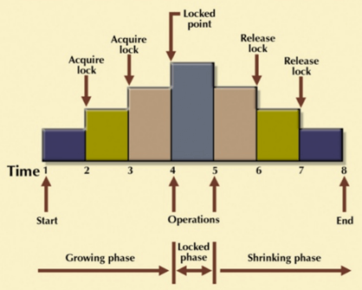
It is true that the 2PL protocol offers serializability. However, it does not ensure that deadlocks do not happen.

Slide 112
Variations of Two-Phase Locking
Strict 2PL
Transaction does not release exclusive locks until after it commits or aborts
Conservative (static) 2PL
Requires a transaction to lock all the items it accesses before the transaction begins
Predeclare read-set and write-set
Deadlock-free protocol

Slide 113
Deadlocks
A deadlock is a condition where two or more transactions are waiting indefinitely for one another to give up locks. Deadlock is said to be one of the most feared complications in DBMS as no task ever gets finished and is in waiting state forever.
For example: In the student table, transaction T1 holds a lock on some rows and needs to update some rows in the grade table. Simultaneously, transaction T2 holds locks on some rows in the grade table and needs to update the rows in the Student table held by Transaction T1.
Now, the main problem arises. Now Transaction T1 is waiting for T2 to release its lock and similarly, transaction T2 is waiting for T1 to release its lock. All activities come to a halt state and remain at a standstill. It will remain in a standstill until the DBMS detects the deadlock and aborts one of the transactions.

Slide 114
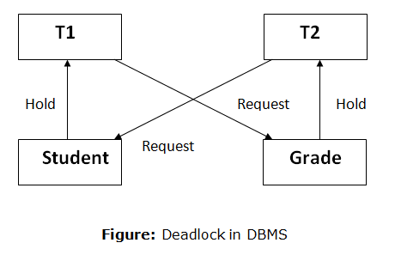
Deadlocks

Slide 115
Deadlocks
T1 | T2
X(A) W(A) X(B) W(B) | X(B) W(B) X(A) W(A)
Here, using strict 2PL, a lock is performed on A since there is a W(A).
Now in T2, we again try to write on A, ie, W(A) but we have already locked A under T1.
Hence there is a deadlock

Slide 116
Deadlock Avoidance
When a database is stuck in a deadlock state, then it is better to avoid the database rather than aborting or restating the database. This is a waste of time and resource.
Deadlock avoidance mechanism is used to detect any deadlock situation in advance. A method like "wait for graph" is used for detecting the deadlock situation but this method is suitable only for the smaller database. For the larger database, deadlock prevention method can be used.

Slide 117
Deadlock Detection
In a database, when a transaction waits indefinitely to obtain a lock, then the DBMS should detect whether the transaction is involved in a deadlock or not. The lock manager maintains a Wait for the graph to detect the deadlock cycle in the database
Wait for Graph
This is the suitable method for deadlock detection. In this method, a graph is created based on the transaction and their lock. If the created graph has a cycle or closed loop, then there is a deadlock.
The wait for the graph is maintained by the system for every transaction which is waiting for some data held by the others. The system keeps checking the graph if there is any cycle in the graph.

Slide 118
Deadlock Detection using wait for graph
Step 1: Draw one vertex for each transaction in the schedule.
Step 2: An edge (Ti -> Tj) is added to the graph if and only if Ti is waiting for Tj.
Step 3: If the graph at any point of time has cycle, it implies deadlock.

Slide 119
Deadlock Detection using wait for graph
T1 | T2 | T3 | T4
X(A) | X(A) X(B) | X(A) | X(B)
T1
T2
T3
T4

Slide 120
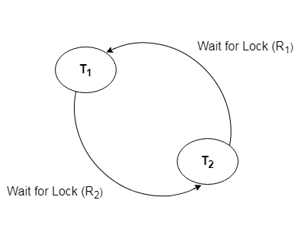
Deadlock Detection using wait for graph
T1 | T2
X(A) W(A) X(B) W(B) | X(B) W(B) X(A) W(A)
T1
T2

Slide 121
Dealing with Deadlock and Starvation
Deadlock Prevention
Deadlock prevention method is suitable for a large database. If the resources are allocated in such a way that deadlock never occurs, then the deadlock can be prevented.
The Database management system analyzes the operations of the transaction whether they can create a deadlock situation or not. If they do, then the DBMS never allowed that transaction to be executed .
Protocols based on a timestamp
Wait-die
Wound-wait

Slide 122
Wait-die :
In this scheme, if a transaction requests for a resource which is already held with a conflicting lock by another transaction then the DBMS simply checks the timestamp of both transactions. It allows the older transaction to wait until the resource is available for execution.
Let's assume there are two transactions Ti and Tj and let TS(T) is a timestamp of any transaction T. If T2 holds a lock by some other transaction and T1 is requesting for resources held by T2 then the following actions are performed by DBMS:
Check if TS(Ti) < TS (Tj) - If Ti is the older transaction and Tj has held some resource, then Ti is allowed to wait until the data-item is available for execution. That means if the older transaction is waiting for a resource which is locked by the younger transaction, then the older transaction is allowed to wait for resource until it is available.
Check if TS(T_{i}) < TS(Tj) - If Ti is older transaction and has held some resource and if Tj is waiting for it, then Tj is killed and restarted later with the random delay but with the same timestamp.

Slide 123
Wound wait scheme
In wound wait scheme, if the older transaction requests for a resource which is held by the younger transaction, then older transaction forces younger one to kill the transaction and release the resource. After the minute delay, the younger transaction is restarted but with the same timestamp.
If the older transaction has held a resource which is requested by the Younger transaction, then the younger transaction is asked to wait until older releases it.

Slide 124
wait-die :
When transaction Ti requests a data item currently held by Tj Ti is allowed to wait only if it has a timestamp smaller than that of Tj (that is, Ti is older than Tj ). Otherwise, Ti is rolled back (dies). This is wait-die.
wound-wait:
When transaction Ti requests a data item currently held by Tj , Ti is allowed to wait only if it has a timestamp larger than that of Tj (that is, Ti is younger than Tj ). Otherwise, Tj is rolled back (Tj is wounded by Ti ). This is wound-wait.

